Slide 1
Employee Retention Prediction
By: Goutham.s

Slide 2
Agenda
Introduction & Problem Statement
Project Objectives
Dataset Overview
Data Understanding & Challenges
Exploratory Data Analysis (EDA)
Data Preprocessing
Model Building & Comparison
Handling Class Imbalance
Final Model Selection
Conclusion

Slide 3
Problem Statement
Employee attrition is a major concern for organisations, especially in highly competitive roles such as data science
High attrition leads to increased recruitment costs, loss of skilled talent, and disruption of ongoing projects
Traditional HR analysis is mostly reactive and fails to identify early warning signals
There is a need for a data-driven predictive approach to identify employees likely to change jobs
Problem Addressed:
Predict job-change likelihood using machine learning techniques.

Slide 4
Project Objectives
To analyse employee demographic, educational, and professional attributes
To identify patterns and trends associated with employee attrition
To perform detailed Exploratory Data Analysis (EDA)
To preprocess data for effective machine learning modelling
To build and compare multiple classification models
To handle class imbalance using appropriate techniques
To select a robust and reliable final model for prediction

Slide 5
Dataset Overview
HR analytics dataset focused on data scientists
Training dataset contains 19,158 employee records
Test dataset contains 2,129 employee records
Dataset includes 14 features, covering:
Demographics
Education background
Work experience
Company-related attributes
Target variable indicates job-change intention

Slide 6
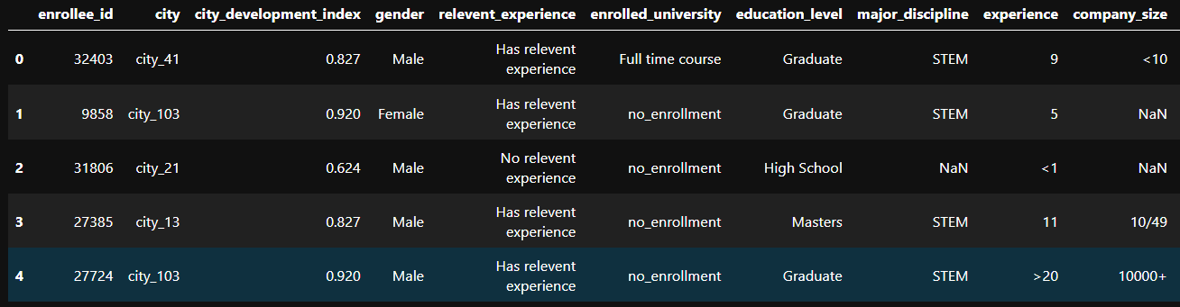
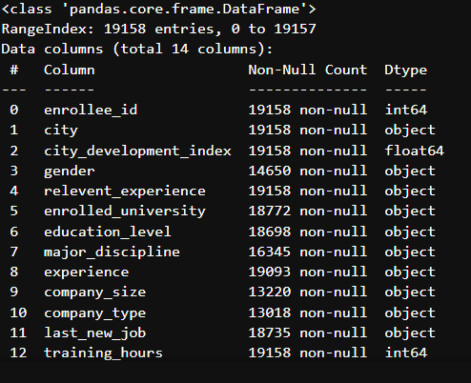
Dataset Overview
DATASET PREVIEW
DF.INFO

Slide 7
Feature Description & Types
Numerical Features:
  city_development_index
  training_hours
Categorical Features:
  gender, education_level, company_size, company_type, etc.
Target Variable:
  0 → Not looking for a job change
  1 → Looking for a job change
Observation:
A large number of categorical features requires encoding before modeling.

Slide 8
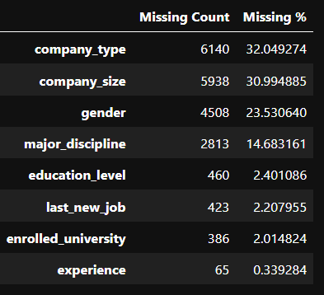
Data Understanding & Challenges
Presence of missing values in multiple categorical columns
High cardinality in certain features such as city
Identifier column (enrollee_id) does not carry predictive meaning
Target variable shows clear imbalance
Impact:
These challenges directly influence model selection and evaluation strategy.

Slide 9
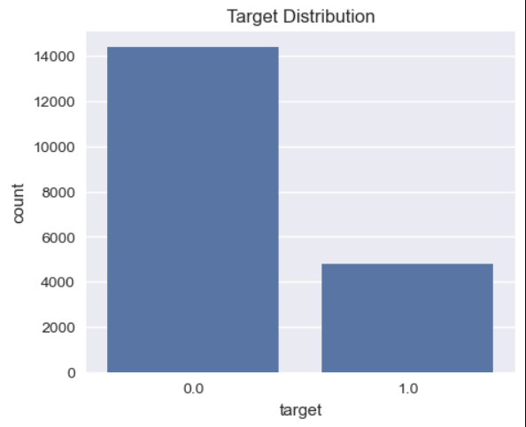
Target Variable Analysis
The majority of employees are not actively looking for a job change
Minority class (job change = 1) is significantly underrepresented
Indicates a class imbalance problem
Why this matters:
Accuracy alone can be misleading
Recall, Precision, F1-score, and ROC-AUC are more appropriate metrics

Slide 10
Exploratory Data Analysis (EDA)
Distribution analysis performed on numerical features
Training hours show high variance and right-skewed distribution
City development index is concentrated toward higher values
enrollee_id shows uniform distribution and no meaningful pattern
Insight:
EDA helps distinguish meaningful predictors from non-informative identifiers.

Slide 11
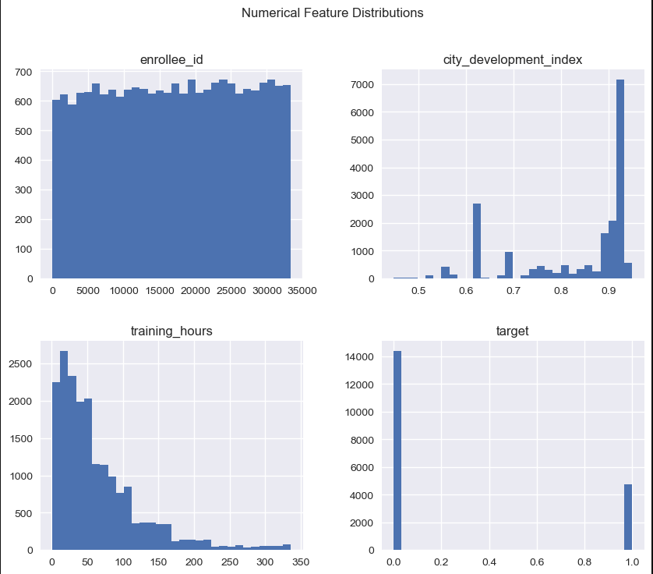
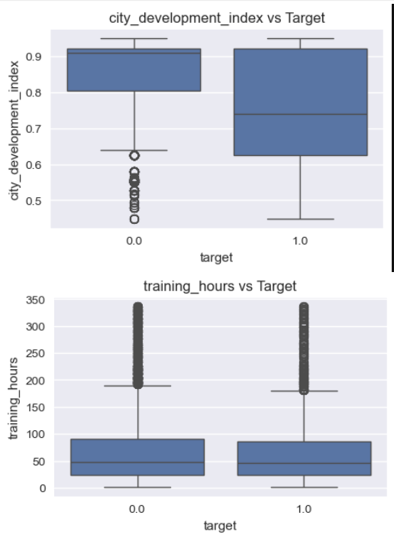
Exploratory Data Analysis (EDA)

Slide 12
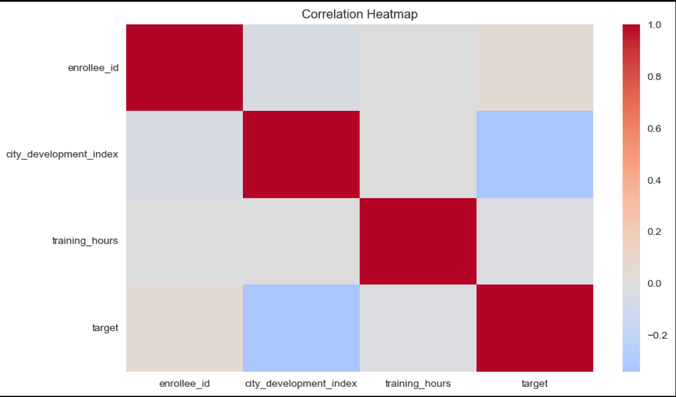
Feature Relationship Analysis
Feature-to-target relationships analysed using boxplots
Employees with higher training hours show a higher job-change tendency
City development index shows variation across target classes
Correlation analysis shows no strong linear relationships
Conclusion:
Tree-based models are suitable for capturing non-linear relationships.

Slide 13
Data Preprocessing
Missing values handled appropriately for categorical features
Categorical variables encoded using Label Encoding
Feature-target split performed
Stratified train–validation split applied to preserve class distribution
Outcome:
Clean and model-ready dataset prepared for training.

Slide 14
Model Building Approach
Multiple classification models implemented to compare performance:
  Logistic Regression
  Random Forest
  XGBoost
  LightGBM
Models chosen to represent:
  Linear methods
  Ensemble methods
  Boosting techniques
Reason:
To identify the most effective model for structured HR data.

Slide 15
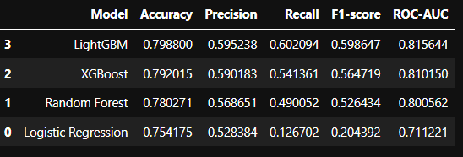
Model Performance Comparison
Logistic Regression struggled with minority class prediction
Random Forest showed improvement but limited recall
Boosting models (XGBoost & LightGBM) performed consistently better
LightGBM achieved the highest overall F1-score

Slide 16
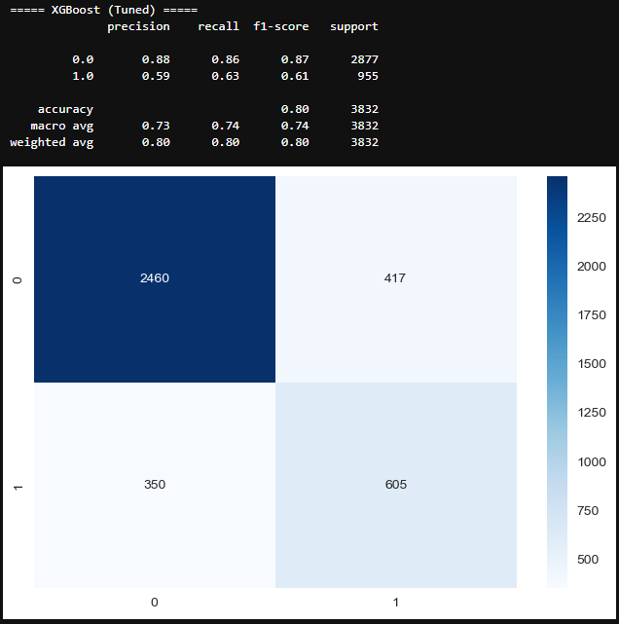
Hyperparameter Tuning
Hyperparameter tuning performed using RandomizedSearchCV on XGBoost
Optimization focused on F1-score due to class imbalance
Tuned model showed improved balance between precision and recall
Result:
More stable and generalised XGBoost model.

Slide 17
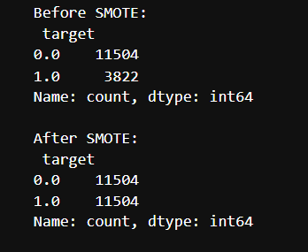
Handling Class Imbalance (SMOTE)
RandomizedSearchCV was applied to optimise:
Number of estimators
Tree depth
Learning rate
Sampling parameters
Goal:
Improve generalization and reduce overfitting.

Slide 18
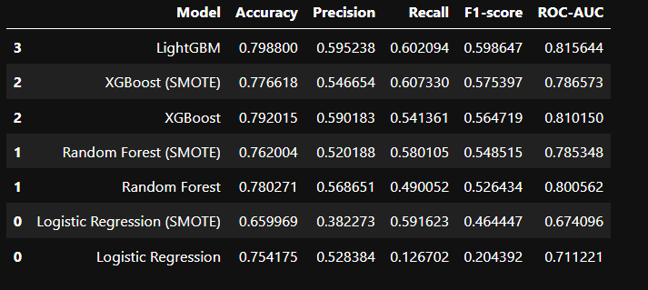
Final Model Selection
SMOTE Impact & Final Model Selection
SMOTE increased recall for job-change class
Precision decreased due to higher false positives
In HR analytics, false positives can lead to unnecessary interventions
Final Model Selected:
Tuned XGBoost (Without SMOTE)
Reason:
Better balance between precision and recall
More reliable predictions
Avoids overestimation of job-change risk

Slide 19
Conclusion & Future Scope
Conclusion
End-to-end machine learning pipeline successfully implemented
Boosting-based models outperformed traditional models
Class imbalance handled carefully using SMOTE experiments
Tuned XGBoost without SMOTE selected as final model
Future Scope
Retrain model after removing identifier features
Add model explainability using SHAP
Deploy as a full-scale HR decision-support system

Slide 20
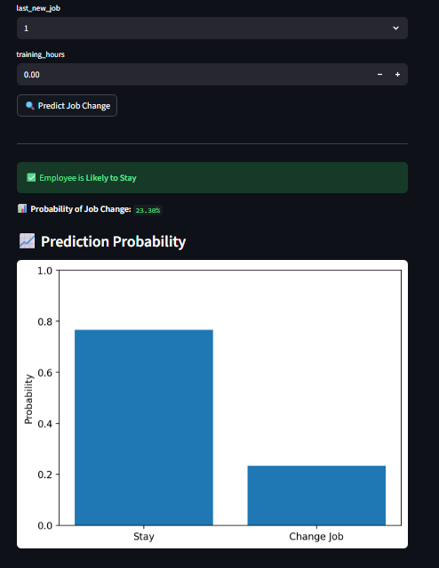

Streamlit UI

Slide 21
App Deployment Using Streamlit
Technology Used
Streamlit – Web application framework
Python – Backend logic
XGBoost – Final trained model
Scikit-learn – Preprocessing utilities
Joblib – Model and encoder serialization
Deployment Workflow
Train and evaluate machine learning models
Select tuned XGBoost model as final
Save trained model and encoders using Joblib
Build Streamlit web interface
Accept employee details as user input
Generate real-time job-change predictions
Display prediction result and probability
Application Features
User-friendly input form
Real-time prediction output
Clear result messages:
  Employee Likely to Stay
  Employee Likely to Change Job
Fast and lightweight execution
Model Integration
Load trained XGBoost model into Streamlit app
Transform user inputs to required feature format
Apply encoding and feature alignment
Generate instant predictions

Slide 22
Thank You!

